Slide 1
Fraud Detection Using ML
Yash Wadgave

Slide 2
Online Payment Fraud Transaction Detection
Develop a model for predicting online fraudulent transactions and use insights from the model to develop and actionable plan.

Slide 3
Data
Used a Fraudulent Transaction detection dataset from Kaggle which contained 6362620 rows and 11 columns.

Slide 4
Workflow
Fetched the data using pandas and performed data cleaning on it. Following through it extracted relevant features and performed Exploratory Data Analysis on cleaned data. Split the data into training and testing set and implement Machine Learning Algorithm on it. Then noted down all of its metrics and tested the model using the testing dataset.

Slide 5
Data Collection
Data Cleaning and Data Mining
Exploratory Data Analysis and Feature Extraction
Splitting data into Training and Testing set
Model Building and Tuning
Iterative
Testing and Prediction

Slide 6
Tools
Python
Pandas
Numpy
Matplotlib
Seaborn
Scikit Learn (Machine Learning Library)

Slide 7
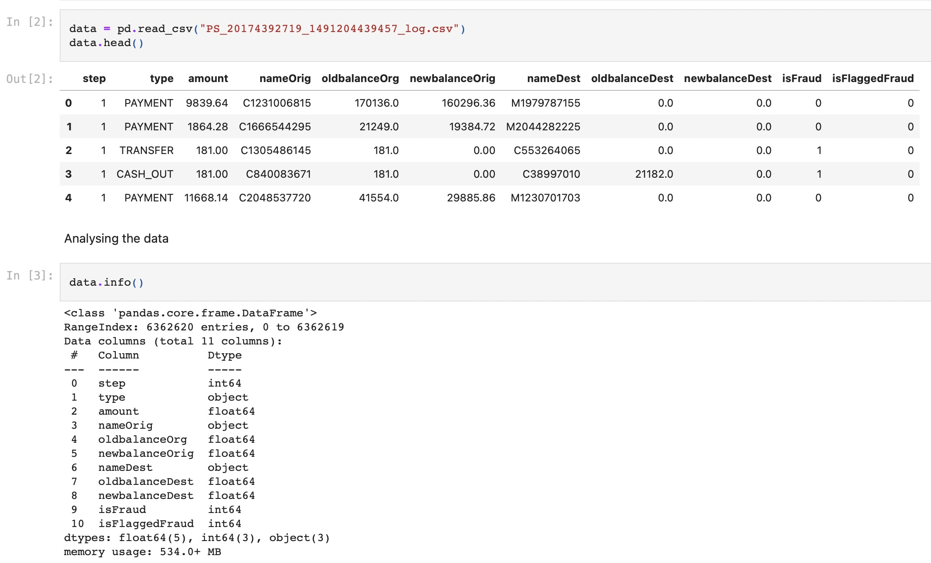
Analysing Data
Cleaning data and analysing there
datatypes and eliminating null values

Slide 8
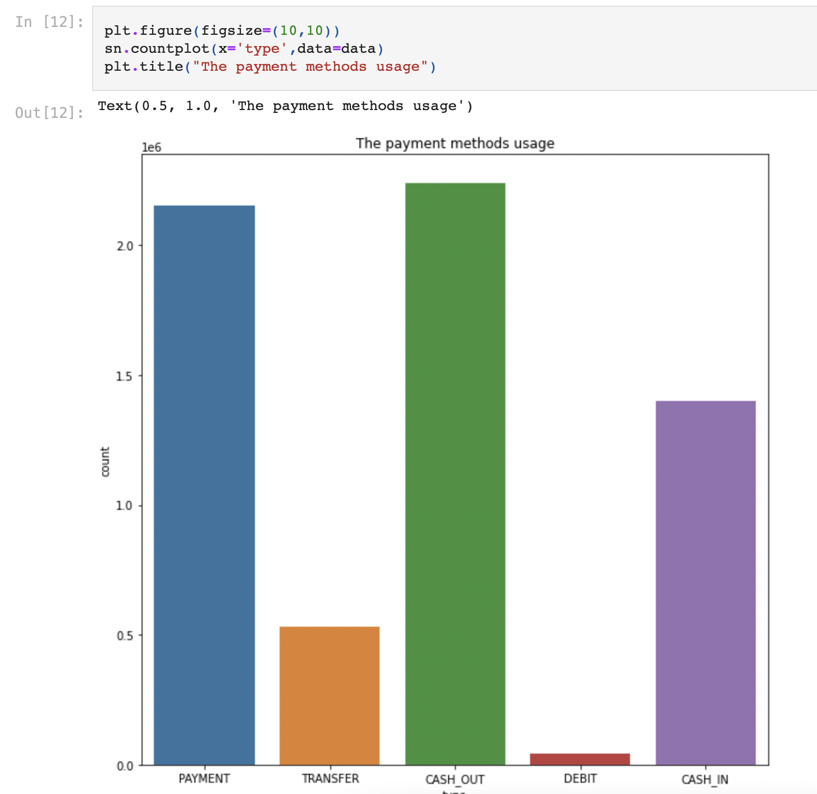
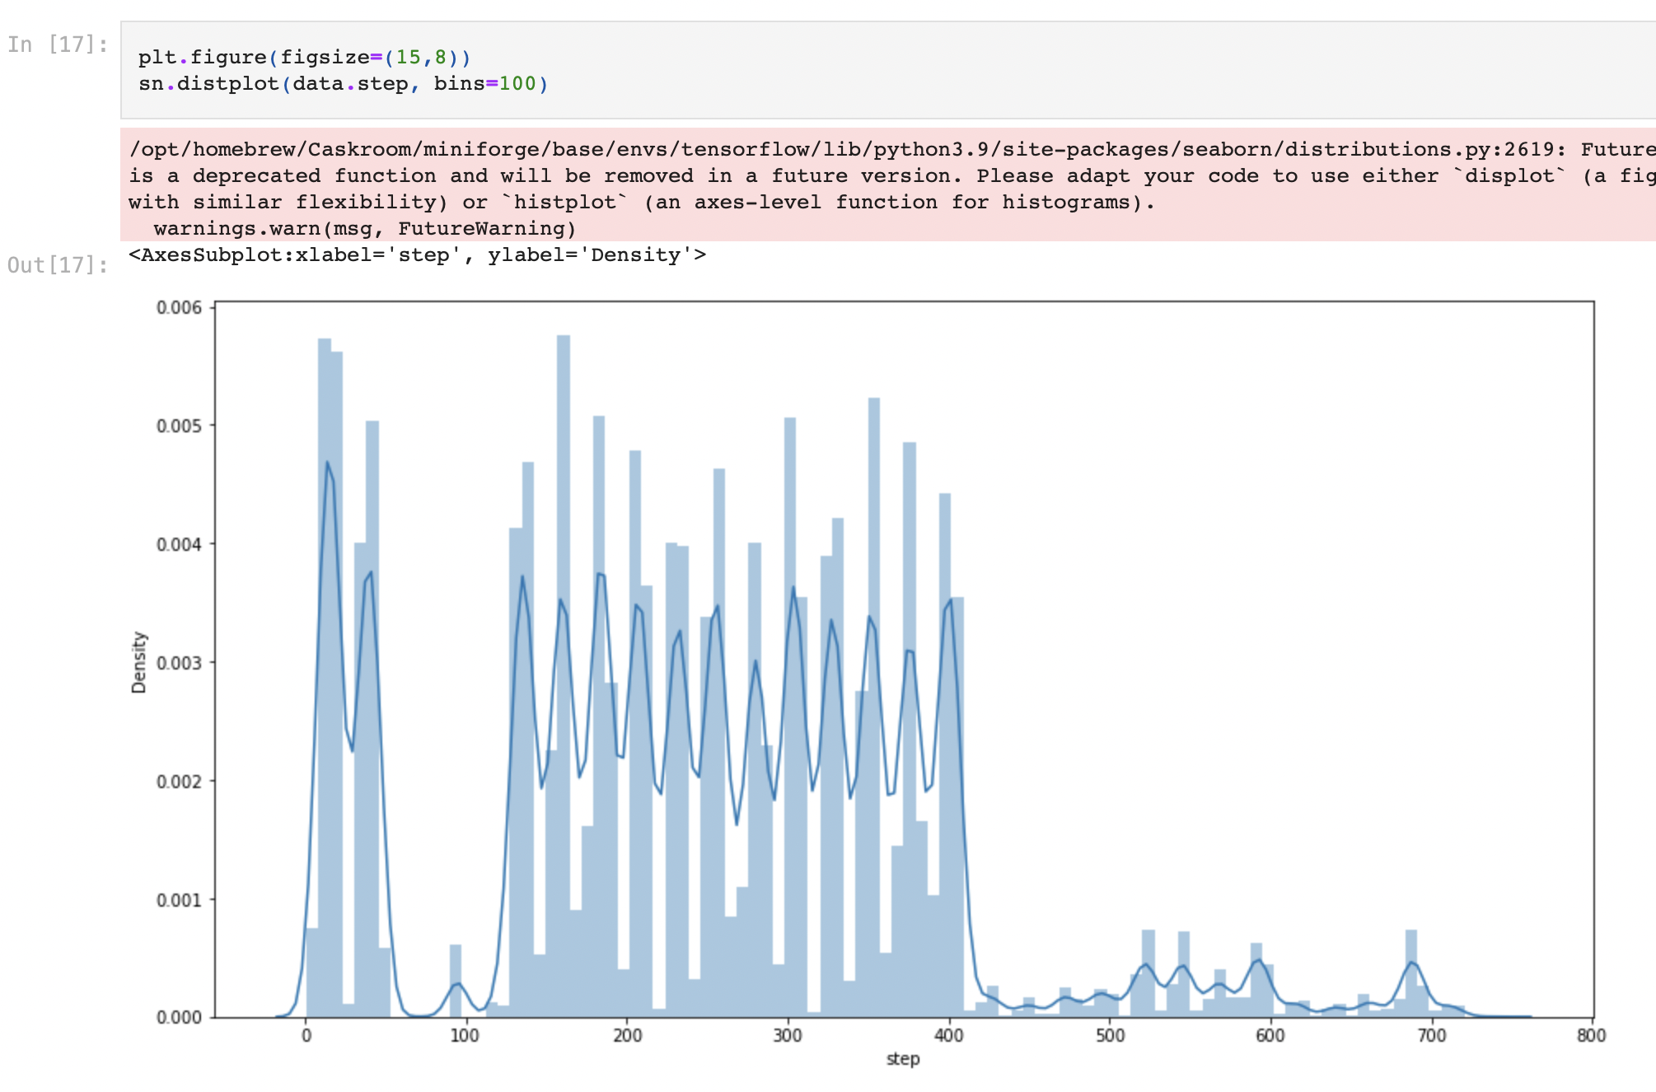
Exploratory Data Analysis
Analysing each feature in the dataset
and plotting it with the target variable to better know the relation between them.

Slide 9
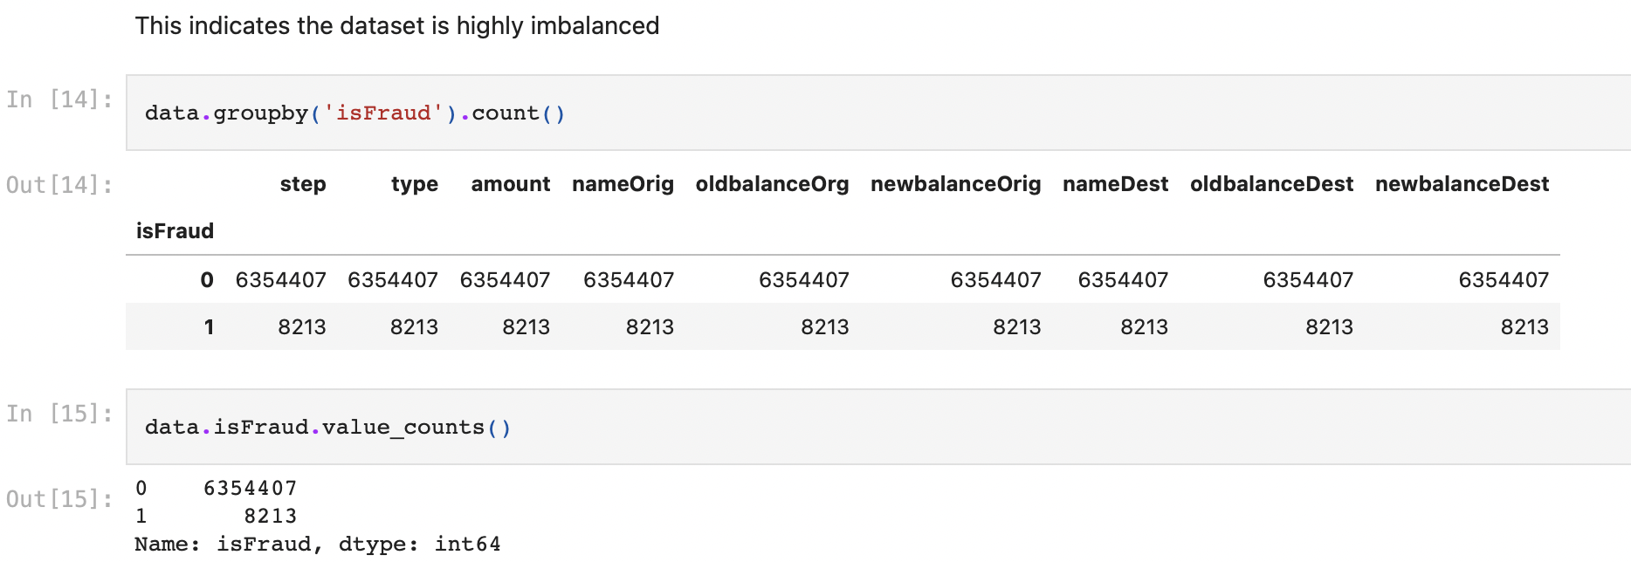
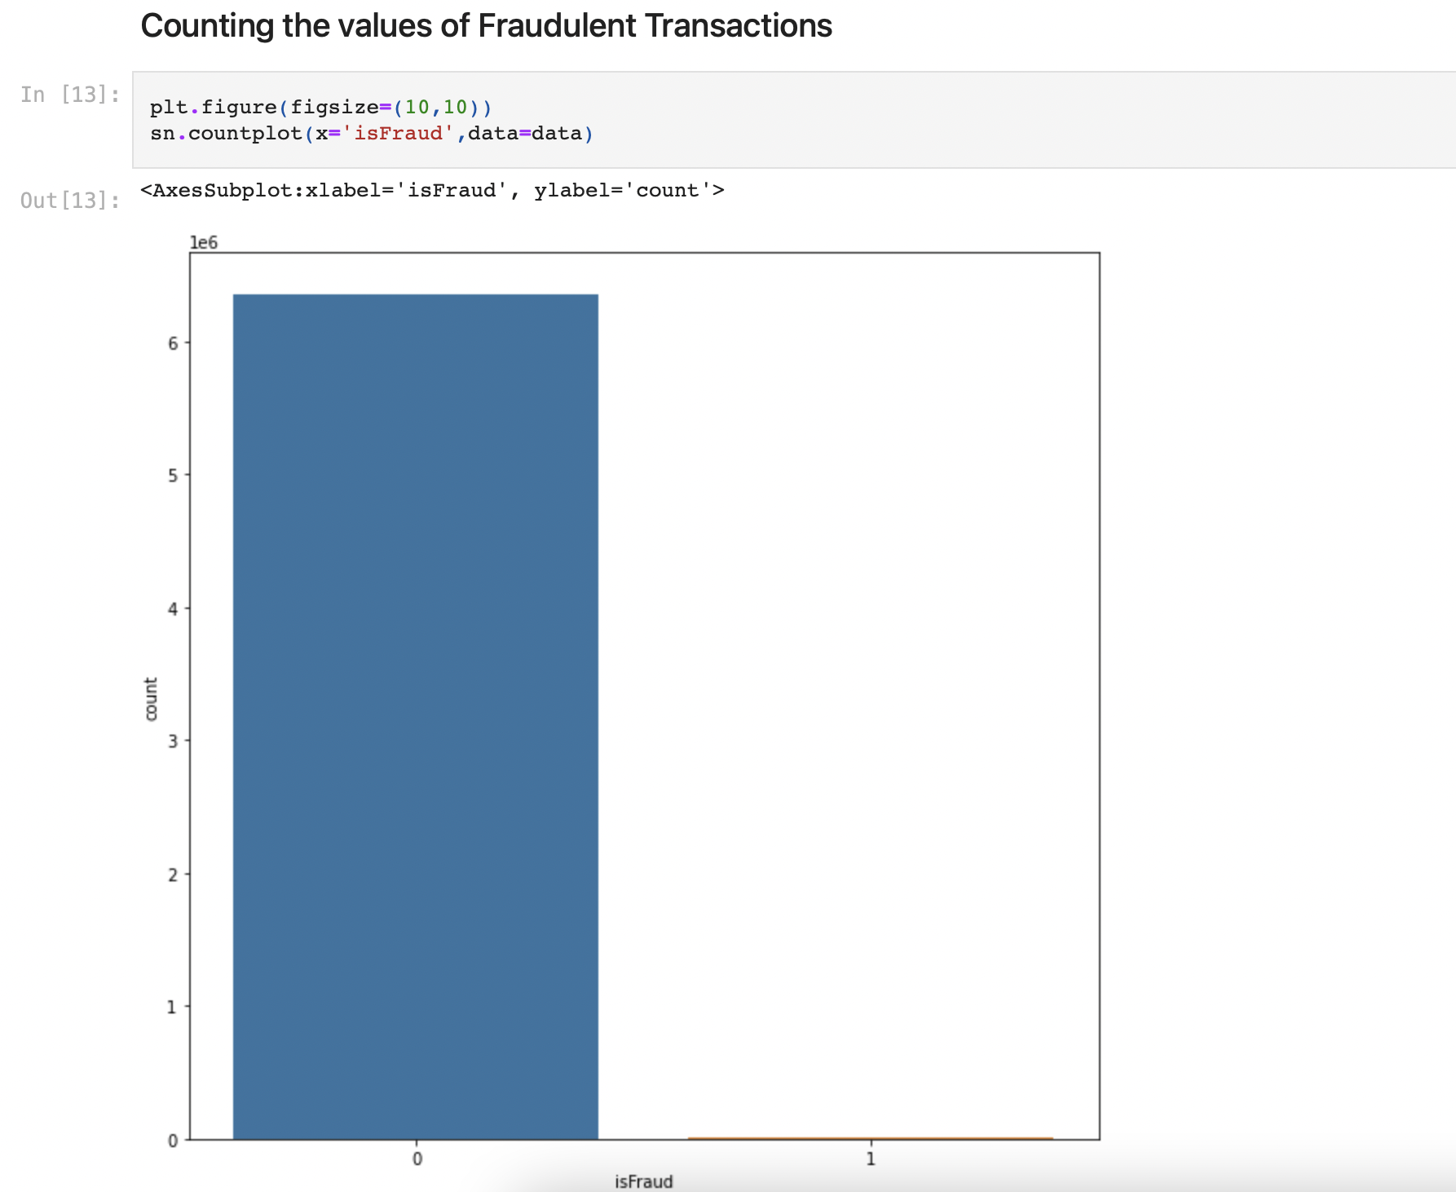
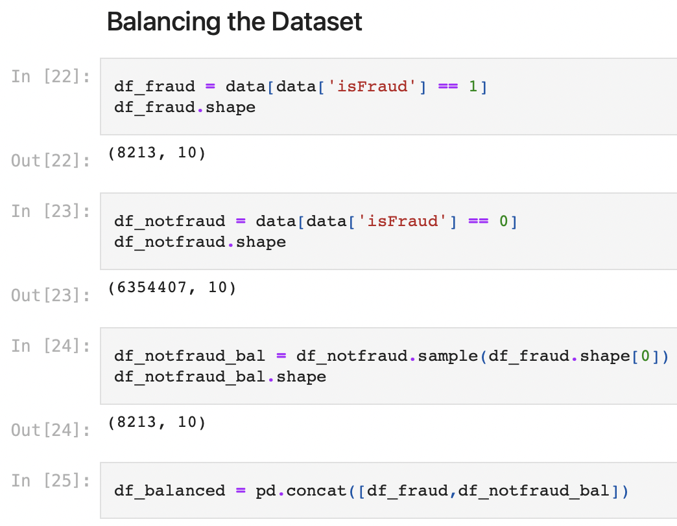
The dataset was highly imbalanced
Balanced the dataset so that the classifier does not get
biased towards the prediction and affect the accuracy of the and its predictions.

Slide 10
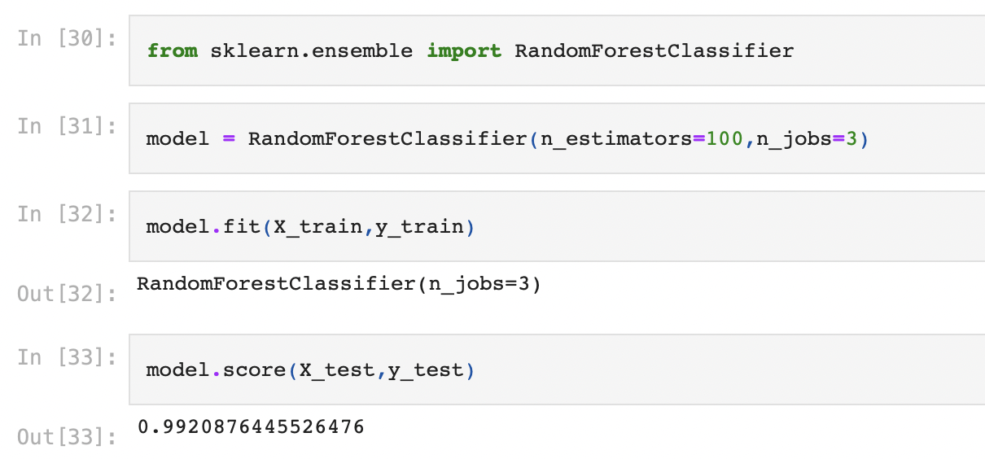
Model Building
Implemented Random Forest Classifier algorithm on the dataset. Achieved an accuracy of 99.20%.

Slide 11
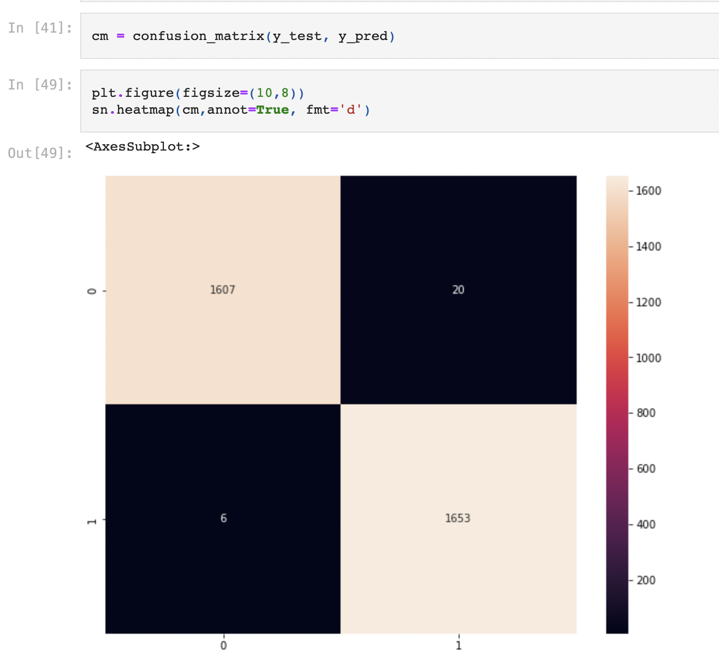
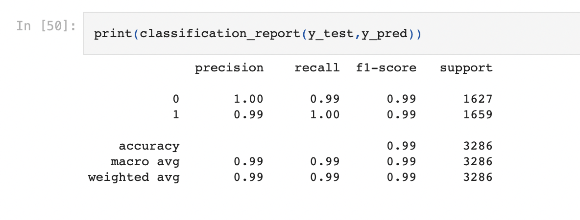
End Results
Plotted heatmap of the confusion matrix.
Printed the Classification Report.

Slide 12
Motivation
Today majority of out transactions are online, we are exposed to fraudulent transaction. Machine Learning helps mitigating those risk by detecting fraudulent transaction and eliminating it.

Slide 13
Thank you

